Slide 1
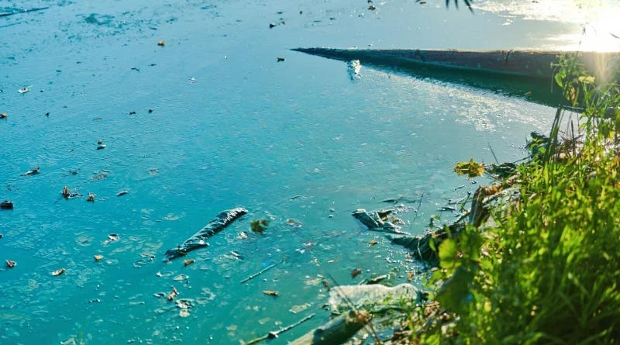
Solutions to Water Pollution

Slide 2
🏭 Treat industrial waste – Factories must clean water before releasing it.
📜 Strict laws & monitoring – Government enforces rules to control pollution.
📢 Awareness programs – Educate people about keeping water clean.
🌊 Better drainage & waste systems – Reduce pollution during floods.
🌳 Plant trees & restore wetlands – Protect rivers and maintain water quality.

